Slide 1
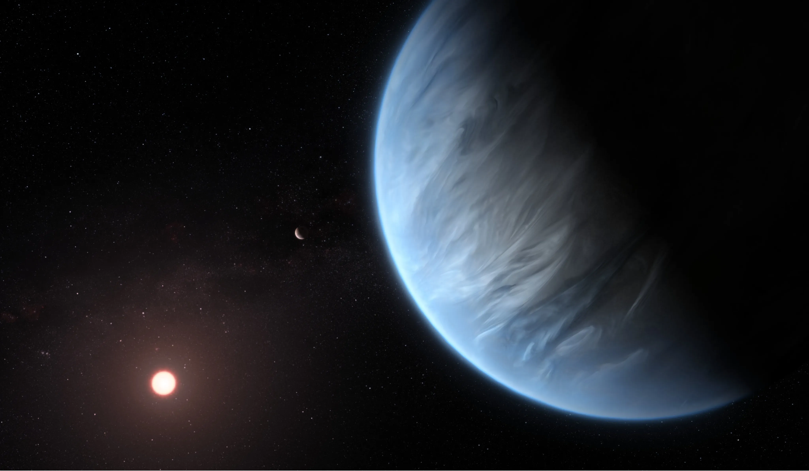
Q1 Machine Learning Project:
Prediction of Confirmed Status of Detected Exoplanet Candidates
Alan Zhu and Leonardo Valli

Slide 2
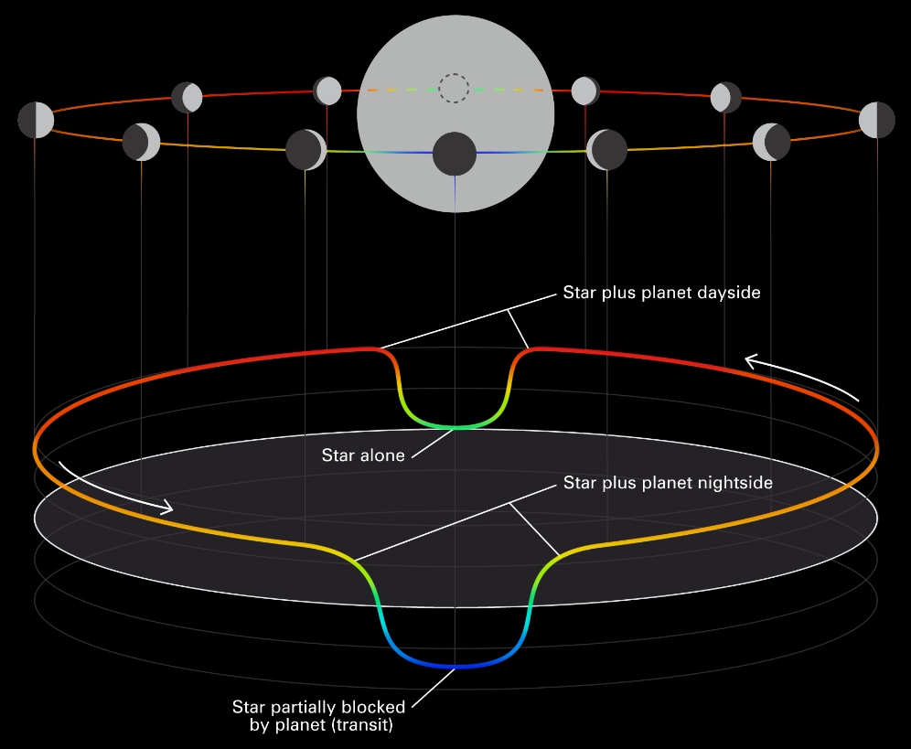
Introduction
Exoplanets are planets orbiting stars other than our sun
Currently ~5,800 confirmed exoplanets
Confirming exoplanet candidates is time-consuming
Goal: Predict confirmed exoplanet status using data about detected exoplanets

Slide 3

Dataset
Transiting Exoplanet Survey Satellite (TESS) Dataset
61 attributes - identification, position, planet properties, stellar properties, dates.
Class - TESS Follow-Up Working Group Disposition (TFOPWG): Confirmed or rejected
https://exofop.ipac.caltech.edu/tess/

Slide 4
Attribute | Meaning
TOI | TESS Object of Interest number - unique identifier for the exoplanet candidate
Planet Orbital Period [days] | Time the planet takes to make a complete orbit around its host star.
Planet Transit Depth [ppm] | The relative flux (brightness) decrease caused by the orbiting body transiting in front of the star.
Planet Radius [R_Earth] | Radius of the planet.
TESS Magnitude | Brightness of the planet.
Stellar Radius [R_Sun] | Radius of the host star.

Slide 5
Preprocessing

Slide 6


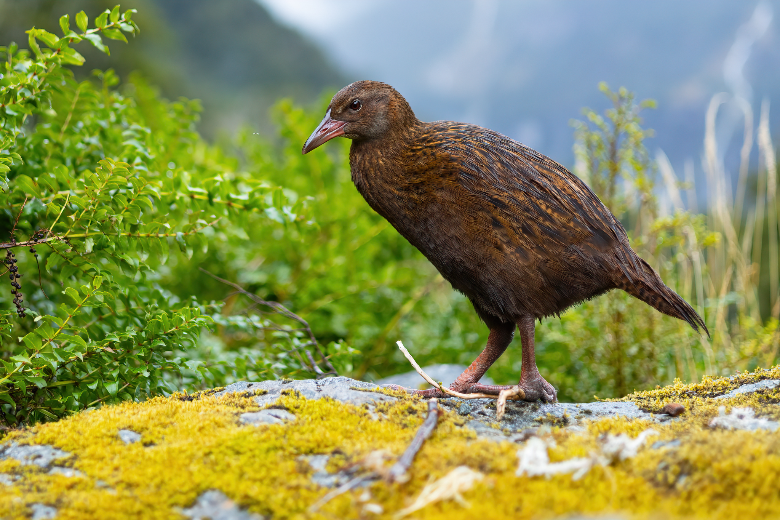

Preprocessing
Done in Python using Google Colab
>

Slide 7
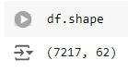
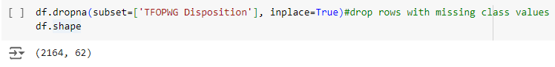
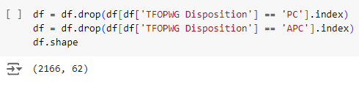
Preprocessing - Instance Removal
Remove instances of planets with no determined status
7,000 → 2,000 instances
Remove Instances with no class value

Slide 8
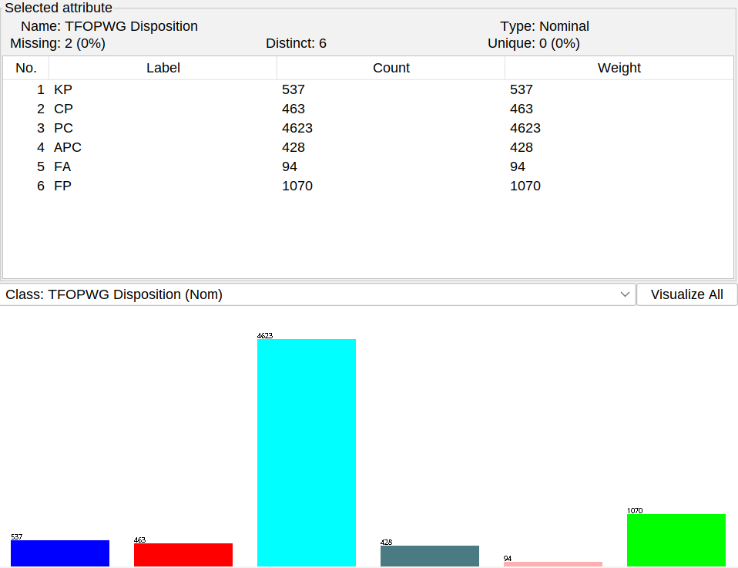
Preprocessing - Binary Encoding
We made our class variable binary
Known Planet (KP) and Confirmed Planet (CP) → True
False Positive (FP) and False Alarm (FA) → False

Slide 9
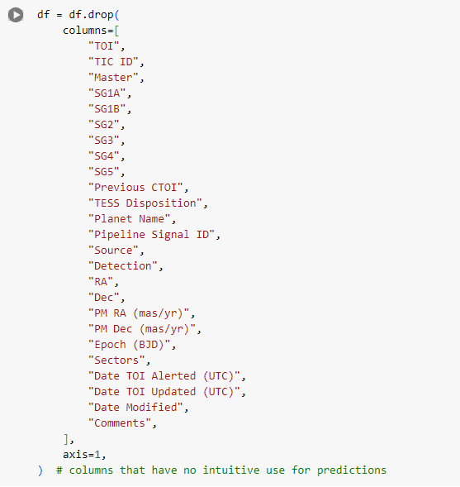
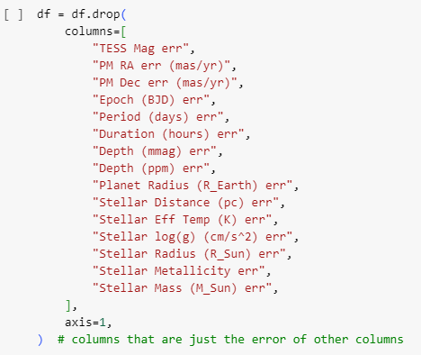
Preprocessing - Preliminary Attribute Removal
Attribute removal: remove attributes we no intuitively have no predictive power
Identifiers
Positions
Dates
Error
62 → 22

Slide 10
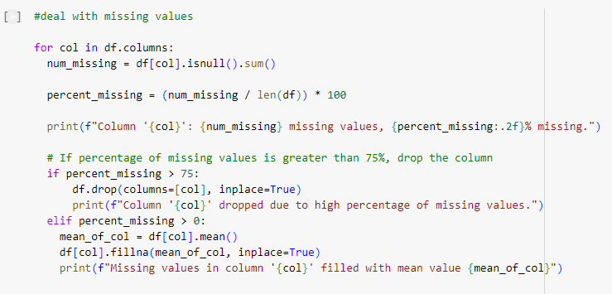
Preprocessing - Handling Missing Values
Initially had 39072 missing values
Remove columns with >75% missing
Stellar Metallicity
Fill in with mean for columns with 0%<missing<75%

Slide 11
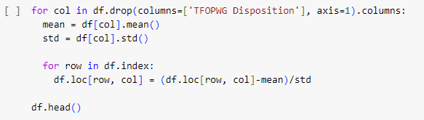
Preprocessing - Normalization
Z-score normalization
Presence of outliers

Slide 12
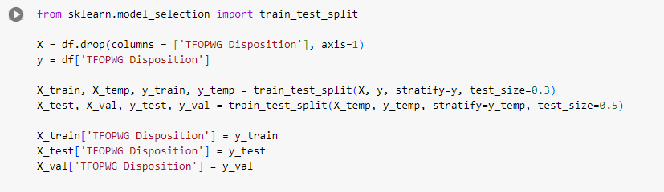
Preprocessing - Train test split
Train-test-validation split: 70% / 15% / 15%
Stratified Random Sampling
Ended up using k-fold cross validation
Weka doesn’t support train-test-validation split

Slide 13
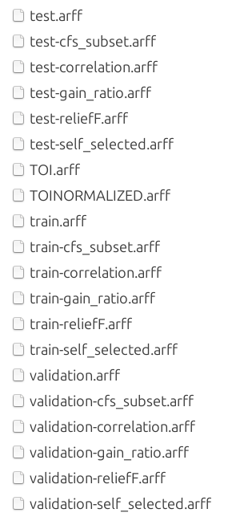



Us when Weka didn’t take our validation set

Slide 14
Attribute Selection

Slide 15
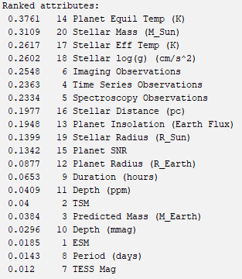
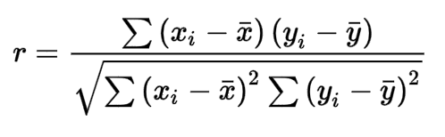
Correlation
Pearson Correlation Coefficient

Slide 16
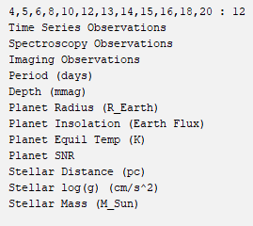
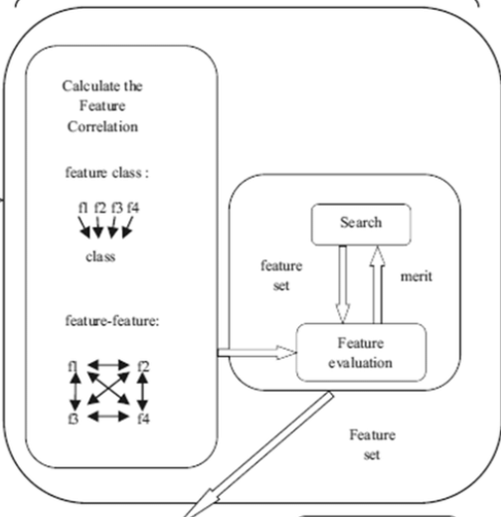
CFS Subset
Correlation-based Feature Subset
Evaluates intercorrelation
12 attributes

Slide 17
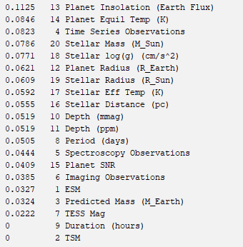
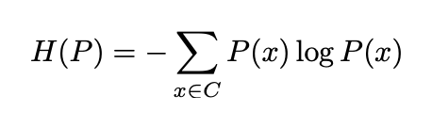
Gain Ratio
Information gain (entropy)
Expected value of information
Probability distribution
(Shannon entropy)

Slide 18
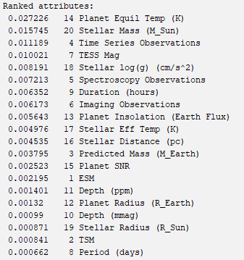
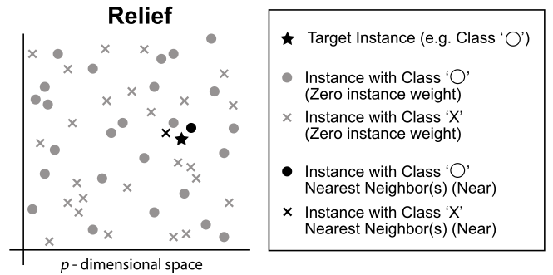
Relief
Calculate feature score
Closest same-class and different-class neighbors
Association between attribute and class and inter-attribute relationships

Slide 19
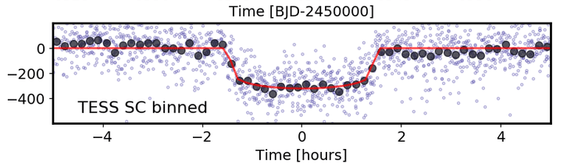
Self-Selected
Planetary characteristics
Stellar characteristics
Significance (depth, SNR)
Number of observations
Depth (ppm)
Planet Radius (R_Earth)
Planet Insolation
Planet Equil Temp (K)
Planet SNR
Stellar Eff Temp (K)
Stellar log(g) (cm/s^2)
Stellar Radius (R_Sun)
Stellar Mass (M_Sun)
Time Series Observations
Spectroscopy Observations
Imaging Observations

Slide 20
Classification

Slide 21
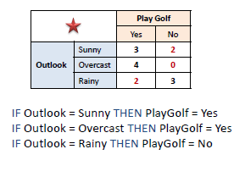
Classification - OneR
For every attribute in the training data:
For every value for that attribute:
For every class value:
Calculate error for the rule value -> class value
Remember the best performing rule for this value
Remember the best performing rules for this attribute
Final rules = best performing rules from one attribute

Slide 22
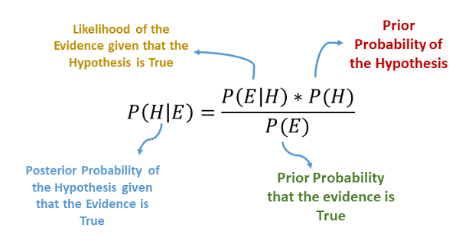
Classification - NaiveBayes
For every class value:
Find percentage of training data that is that class
For every attribute:
For every value of that attribute:
Calculate likelihood of that class having that value
Classification = max(percentage * likelihoods)

Slide 23
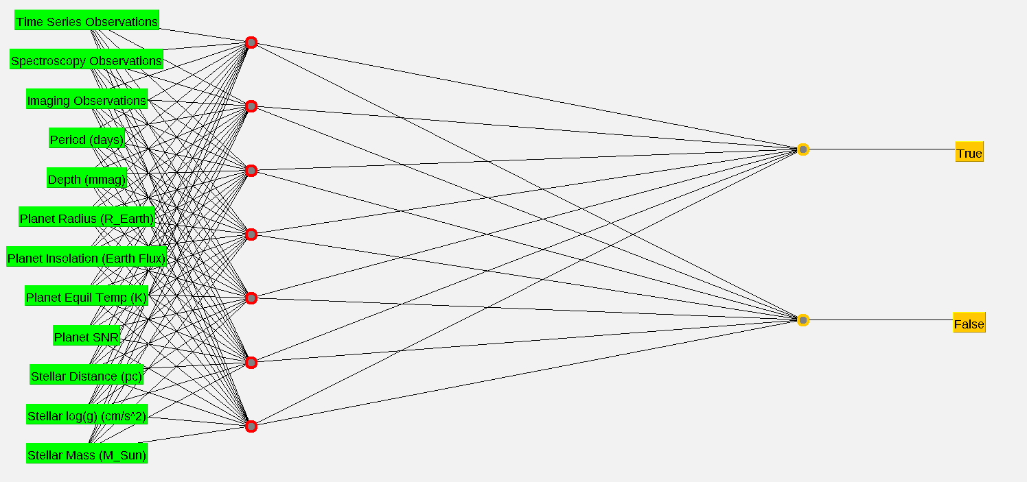
Classification - MultilayerPerceptron
Initialize random base weights for network
For every instance in the training set:
Make prediction using current weights
Calculate loss (e.g., Mean Squared Error) by comparing prediction to actual class
For every weight in the NeuralNet:
Update via gradient descent

Slide 24
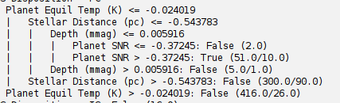
Classification - J48

Slide 25
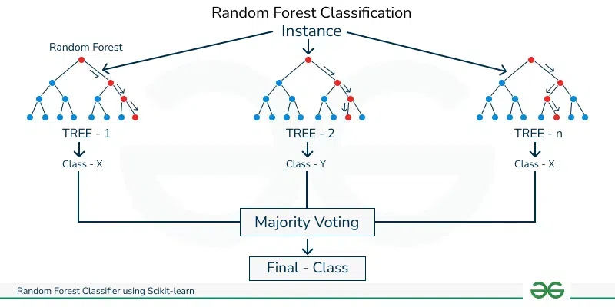
Classification - RandomForests
For i in range(n):
Create decision tree
For i in range(n): #Classification
Have the i-th decision tree make a prediction on the test instance
Classification = Class with the most votes from the decision trees

Slide 26
Results

Slide 27
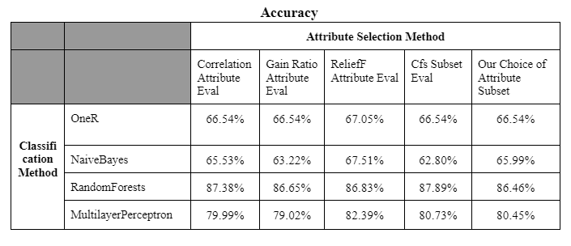
Results - Accuracies

Slide 28
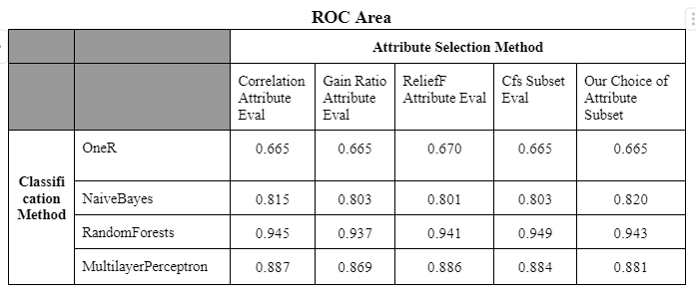
Results - Area under ROC Curve

Slide 29
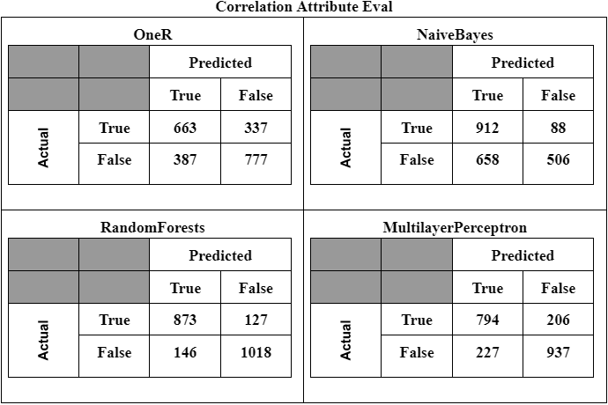
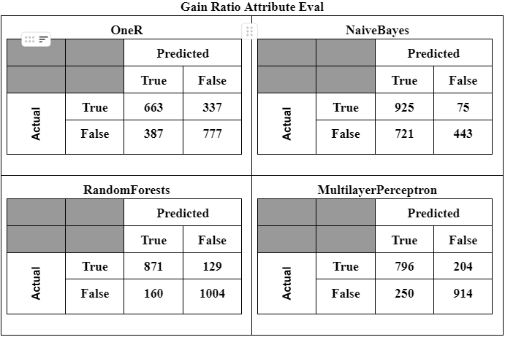
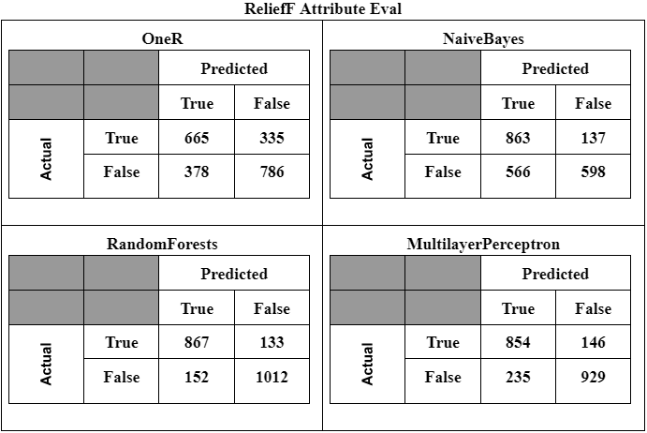
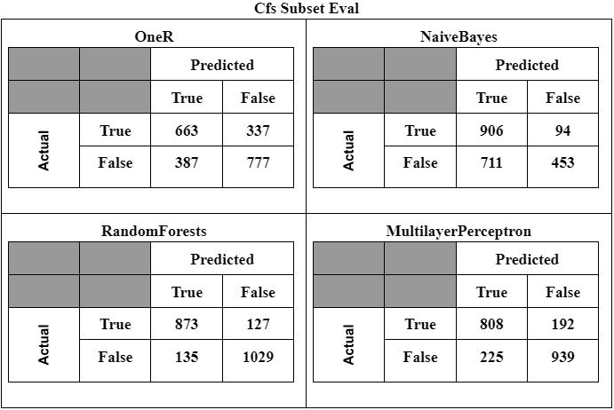
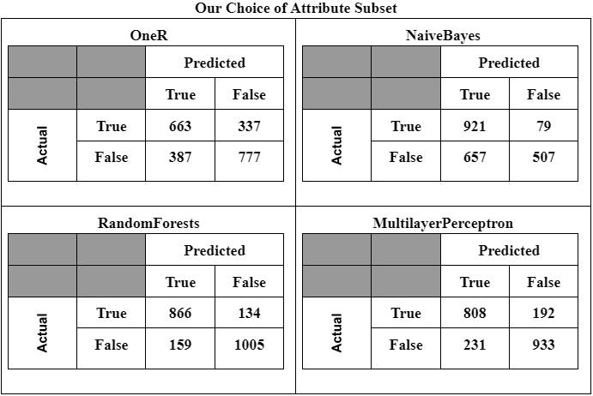
Results - Confusion Matrices

Slide 30

Final Precision: 0.866
Final Recall: 0.873

Slide 31
Conclusions

Slide 32
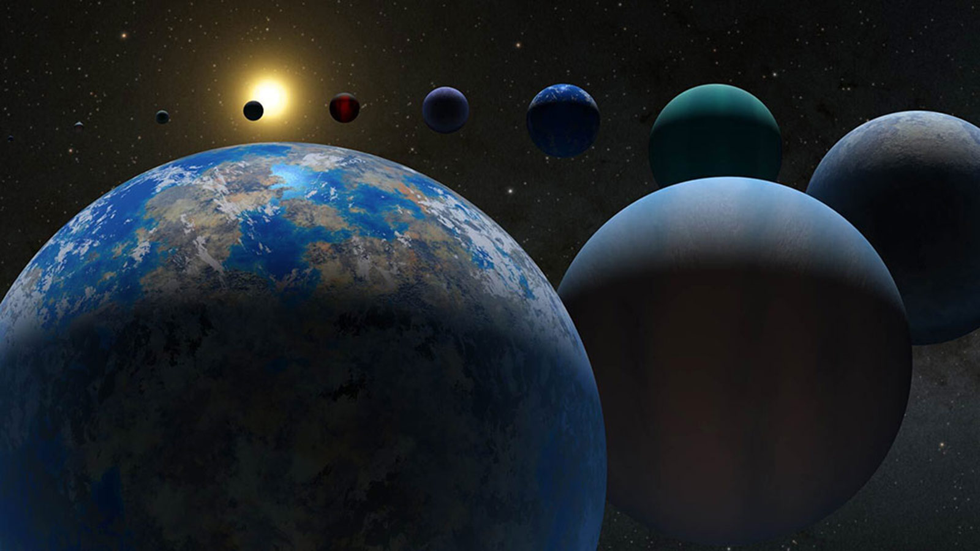
Conclusions
Our model is highly accurate (88%) at predicting confirmed exoplanet status
Can be used as a tool to assist astronomers in confirming exoplanets
Selecting priority follow-up observations
Save valuable time: research telescopes, computing clusters, scientists
No ML model has been developed for this dataset before
Possible future direction: train a larger neural network
96% accuracy with astronomers’ input

Slide 33
Thanks for your attention ;)

